Slide 1
Efficient Algorithms
Ekkapot Charoenwanit
Software Systems Engineering
TGGS
KMUTNB

Slide 2
Lecture 12: Approximation Algorithms

Slide 3
Solving Hard Problems
Currently, we do not know any polynomial-time algorithms for any NP-complete problems.
Therefore, solving them exactly is bound to be computationally expensive for sufficiently large problem sizes.
Yet, many of NP-complete are too important to abandon just because we do not know how to solve them optimally.

Slide 4
Solving Hard Problems
The following are strategies we can use to solve NP-complete problems:
Solve them optimally using an exponential-time algorithm
This works for problem sizes that are not too large
Solve special cases for which we know polynomial-time algorithms
Solve them sub-optimally in polynomial time with approximation algorithms
Approximate solutions are guaranteed to differ from optimal solutions within certain factors called approximation ratios

Slide 5
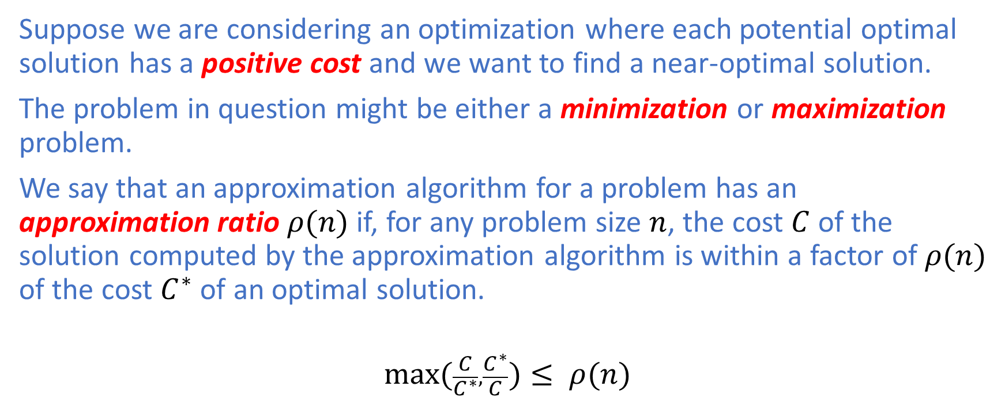
Approximation Ratios
Suppose we are considering an optimization where each potential optimal solution has a positive cost and we want to find a near-optimal solution.
The problem in question might be either a minimization or maximization problem.
We say that an approximation algorithm for a problem has an approximation ratio $ρ(n)$ if, for any problem size $n$, the cost $C$ of the solution computed by the approximation algorithm is within a factor of $ρ(n)$ of the cost $C^{∗}$ of an optimal solution.
$$\max_{}{(\frac{C}{C^{∗}},\frac{C^{∗}}{C}})≤ ρ(n)$$

Slide 6
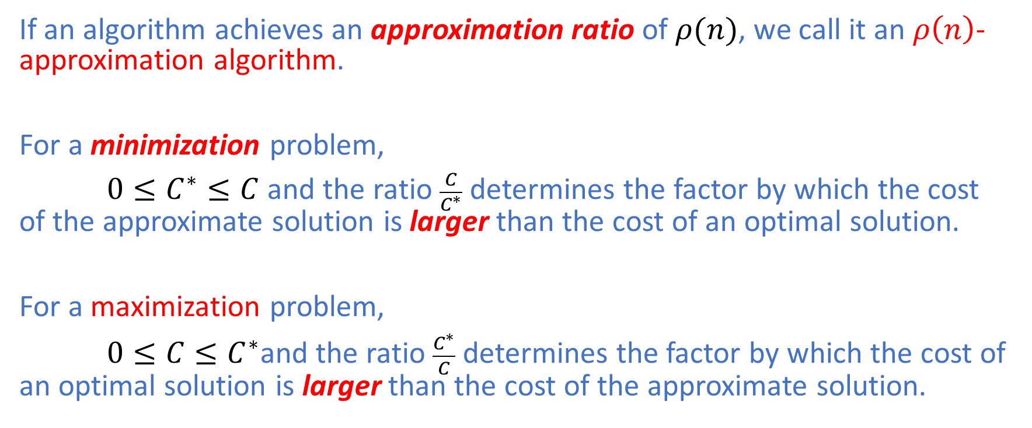
Approximation Ratios
If an algorithm achieves an approximation ratio of $ρ(n)$, we call it an $ρ\left(n\right)$-approximation algorithm.
For a minimization problem,
$0≤C^{∗}≤C$ and the ratio $\frac{C}{C^{∗}}$ determines the factor by which the cost of the approximate solution is larger than the cost of an optimal solution.
For a maximization problem,
$0≤C≤C^{∗}$and the ratio $\frac{C^{∗}}{C}$ determines the factor by which the cost of an optimal solution is larger than the cost of the approximate solution.

Slide 7
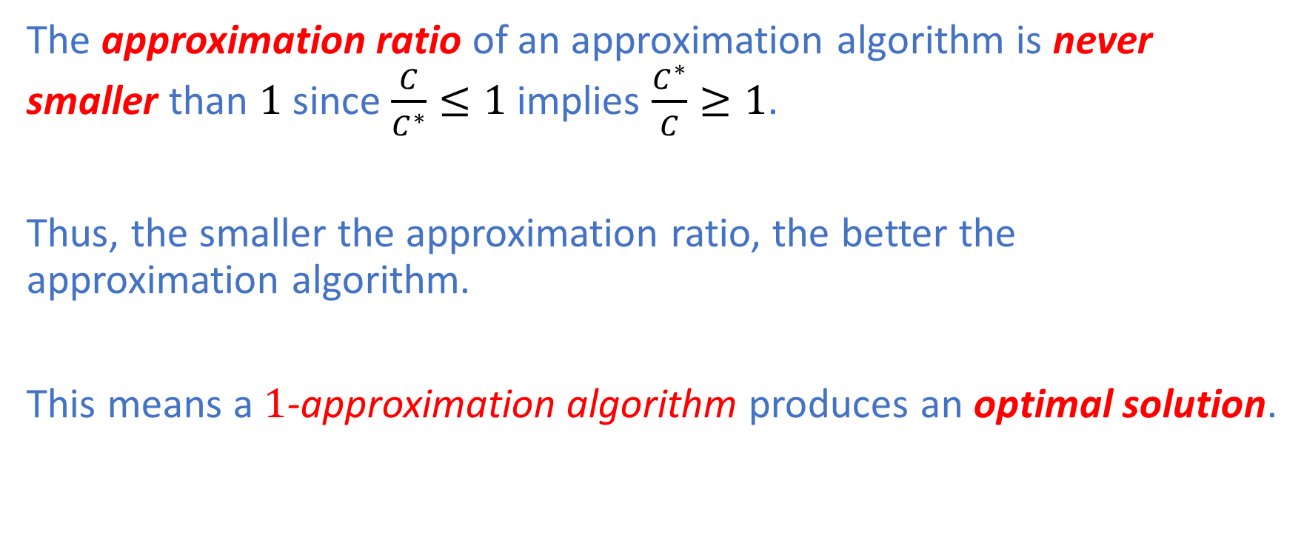
Approximation Ratios
The approximation ratio of an approximation algorithm is never smaller than $1$ since $\frac{C}{C^{∗}}≤1$ implies $\frac{C^{∗}}{C}≥1$.
Thus, the smaller the approximation ratio, the better the approximation algorithm.
This means a $1$-approximation algorithm produces an optimal solution.

Slide 8
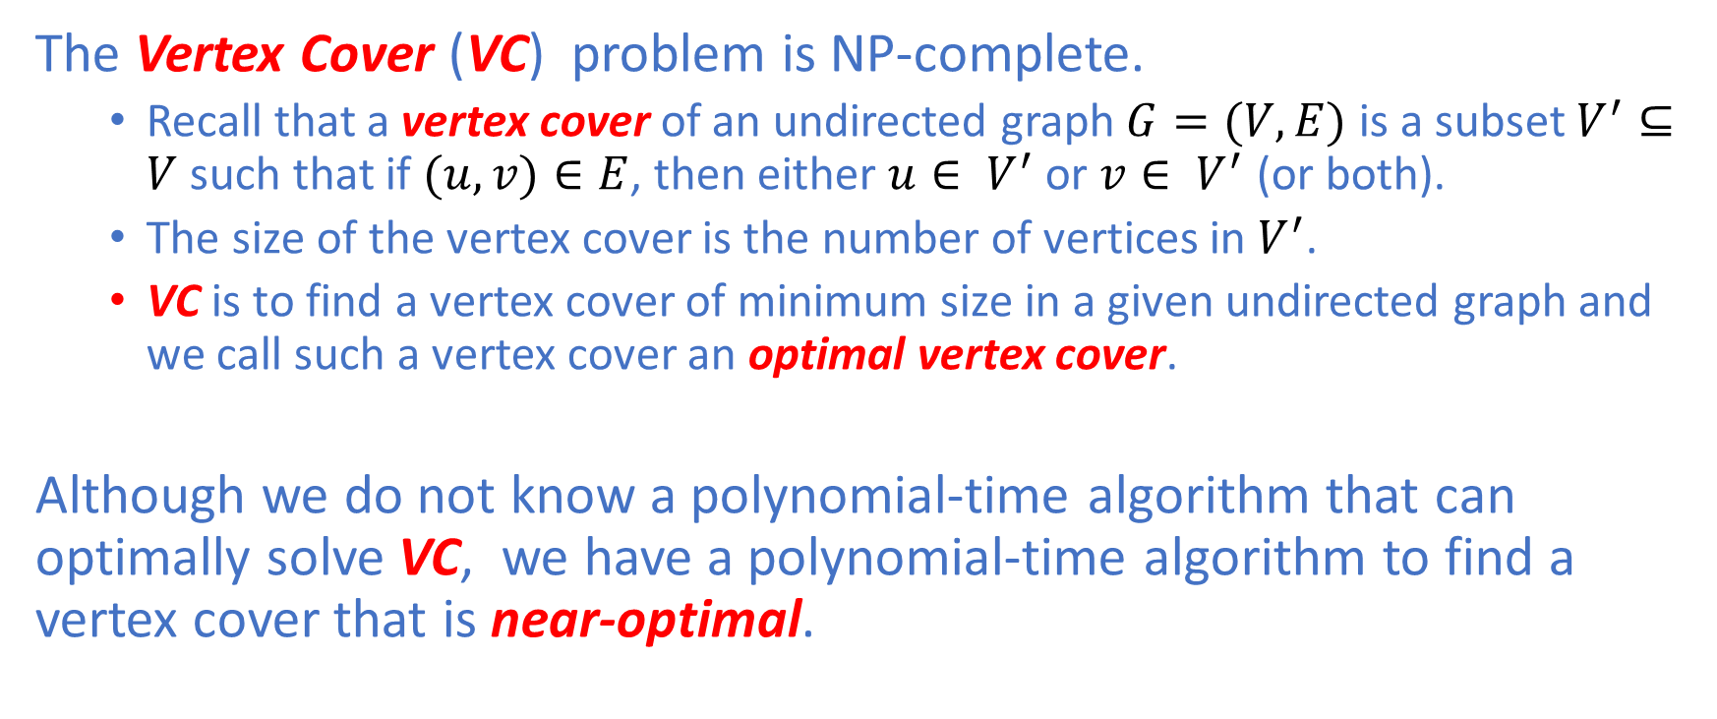
Vertex Cover
The Vertex Cover (VC) problem is NP-complete.
Recall that a vertex cover of an undirected graph $G=(V,E)$ is a subset $V^{′}⊆V$ such that if $(u,v)∈E$, then either $u∈ V^{′}$ or $v∈ V^{′}$ (or both).
The size of the vertex cover is the number of vertices in $V^{′}$.
VC is to find a vertex cover of minimum size in a given undirected graph and we call such a vertex cover an optimal vertex cover.
Although we do not know a polynomial-time algorithm that can optimally solve VC, we have a polynomial-time algorithm to find a vertex cover that is near-optimal.

Slide 9
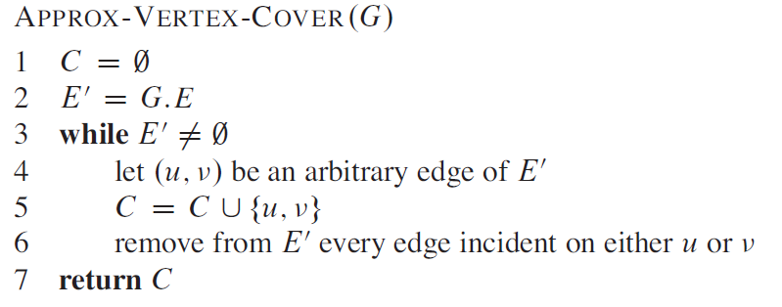

Vertex Cover
The approximate algorithm takes $G=(V,E)$ as input and returns a vertex cover $V^{′}$ whose size is guaranteed to be no larger than twice the size of an optimal vertex cover ${V^{′}}_{opt}$, hence a $2$-approximation algorithm.

Slide 10
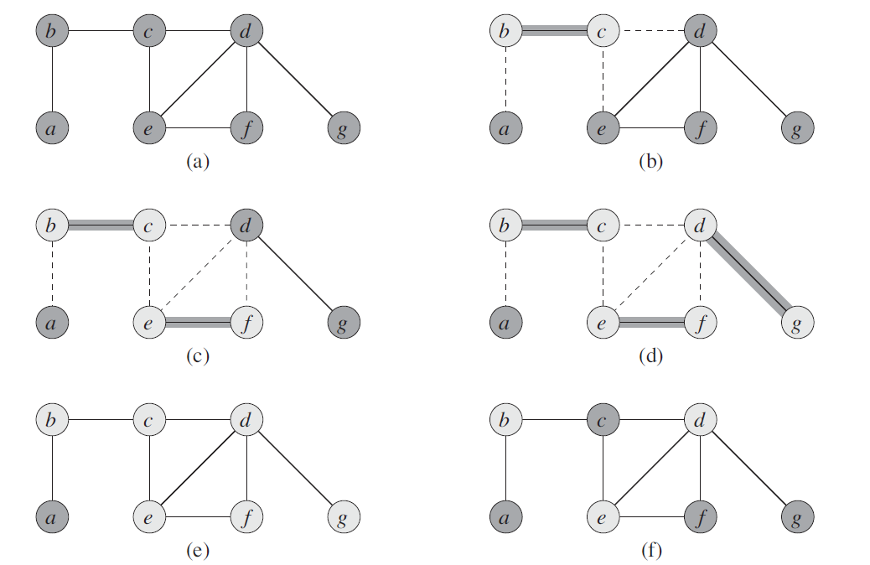
Vertex Cover: Example

Slide 11
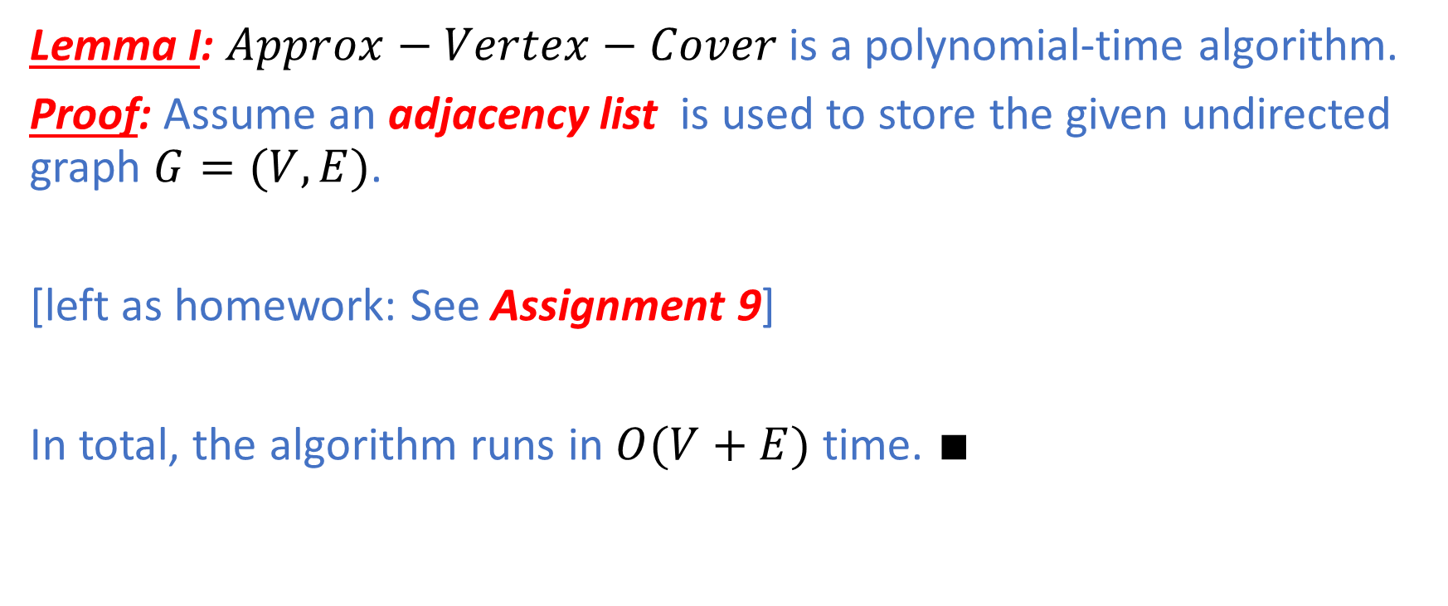
Vertex Cover
Lemma I: $Approx−Vertex−Cover$ is a polynomial-time algorithm.
Proof: Assume an adjacency list is used to store the given undirected graph $G=(V,E)$.
[left as homework: See Assignment 9]
In total, the algorithm runs in $O(V+E)$ time. $∎$

Slide 12
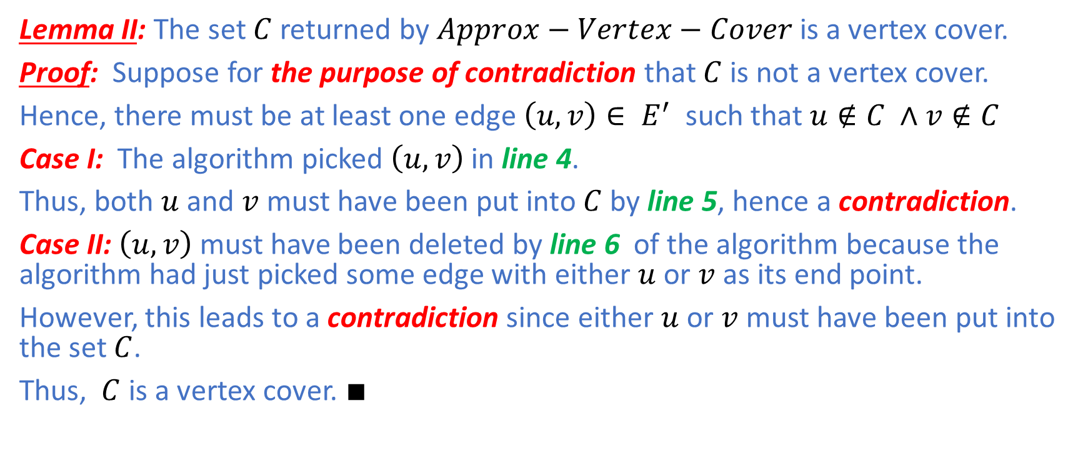
Vertex Cover
Lemma II: The set $C$returned by $Approx−Vertex−Cover$ is a vertex cover.
Proof: Suppose for the purpose of contradiction that $C$ is not a vertex cover.
Hence, there must be at least one edge $\left(u,v\right)∈ E^{′}$ such that $u∉C ∧v∉C$
Case I: The algorithm picked $\left(u,v\right)$in line 4.
Thus, both $u$ and $v$ must have been put into $C$ by line 5, hence a contradiction.
Case II: $\left(u,v\right)$ must have been deleted by line 6 of the algorithm because the algorithm had just picked some edge with either $u$ or $v$ as its end point.
However, this leads to a contradiction since either $u$ or $v$ must have been put into the set $C$.
Thus, $C$ is a vertex cover. $∎$

Slide 13
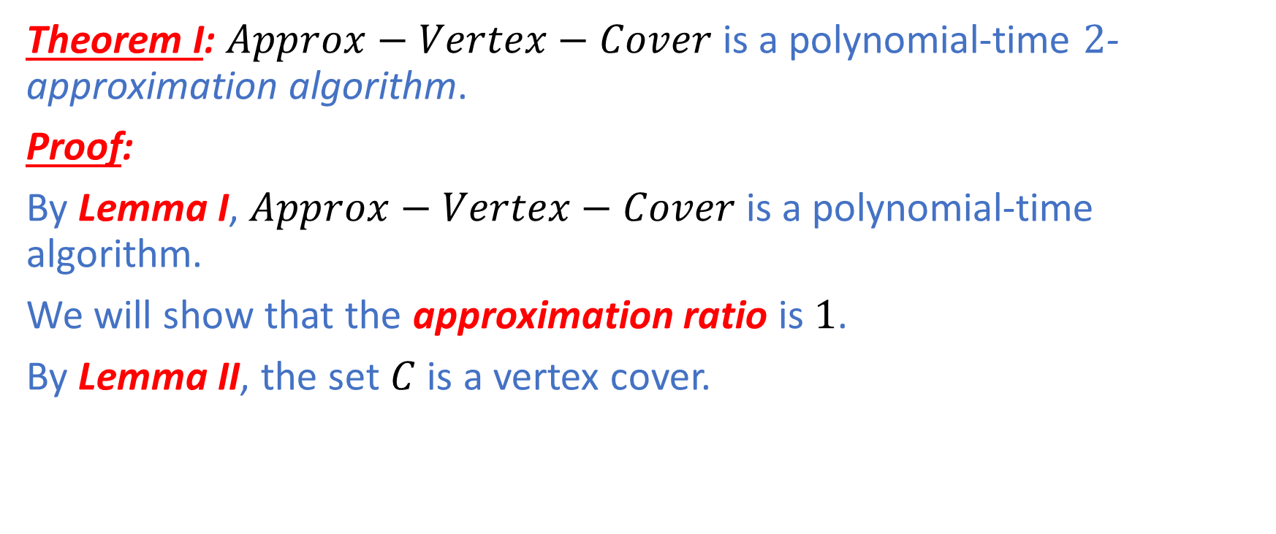
Vertex Cover
Theorem I: $Approx−Vertex−Cover$ is a polynomial-time $2$-approximation algorithm.
Proof:
By Lemma I, $Approx−Vertex−Cover$ is a polynomial-time algorithm.
We will show that the approximation ratio is $1$.
By Lemma II, the set $C$ is a vertex cover.

Slide 14
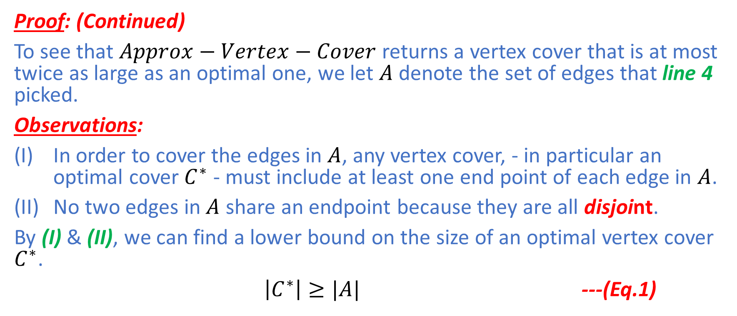
Vertex Cover
Proof: (Continued)
To see that $Approx−Vertex−Cover$ returns a vertex cover that is at most twice as large as an optimal one, we let $A$ denote the set of edges that line 4 picked.
Observations:
In order to cover the edges in $A$, any vertex cover, - in particular an optimal cover $C^{∗}$ - must include at least one end point of each edge in $A$.
No two edges in$A$ share an endpoint because they are all disjoint.
By (I) & (II), we can find a lower bound on the size of an optimal vertex cover $C^{∗}$.
$\left|C^{∗}\right|≥|A|$ ---(Eq.1)

Slide 15
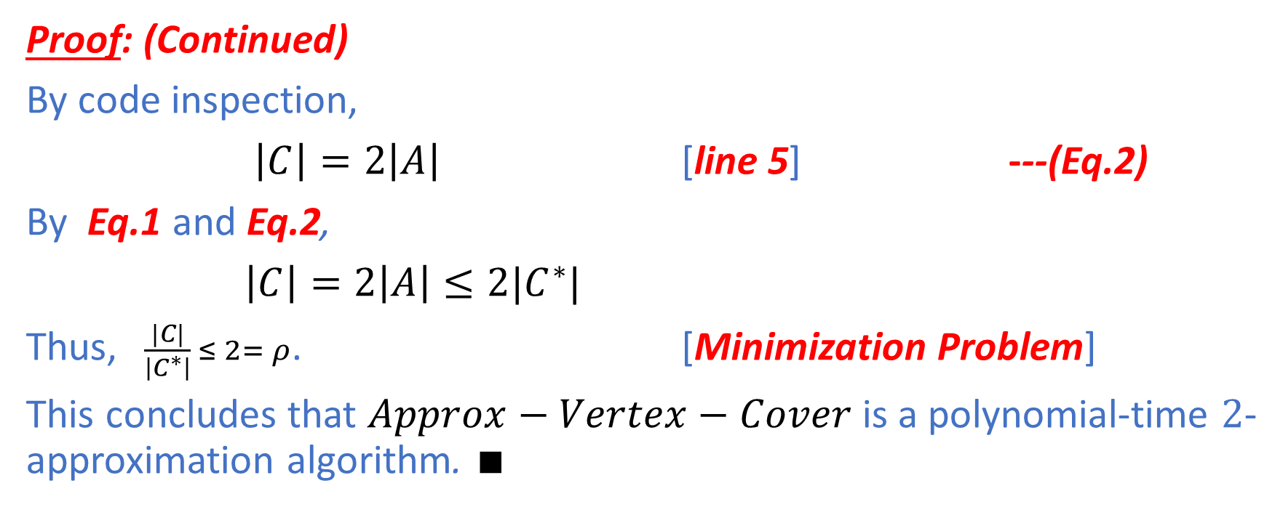
Vertex Cover
Proof: (Continued)
By code inspection,
$\left|C\right|=2\left|A\right|$ [line 5] ---(Eq.2)
By Eq.1 and Eq.2,
$\left|C\right|=2\left|A\right|≤2|C^{∗}|$
Thus, $\frac{|C|}{\left|C^{∗}\right|} ≤ 2= ρ$. [Minimization Problem]
This concludes that $Approx−Vertex−Cover$ is a polynomial-time $2$-approximation algorithm. $∎$

Slide 16
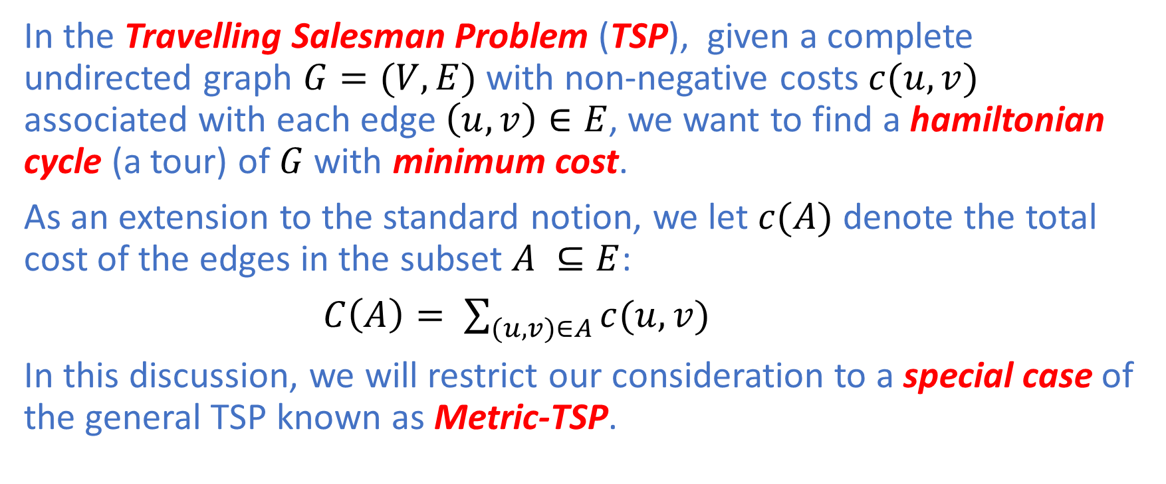
Travelling Salesman
In the Travelling Salesman Problem (TSP), given a complete undirected graph $G=(V,E)$ with non-negative costs $c(u,v)$ associated with each edge $\left(u,v\right)∈E$, we want to find a hamiltonian cycle (a tour) of $G$ with minimum cost.
As an extension to the standard notion, we let $c(A)$ denote the total cost of the edges in the subset $A ⊆E$:
$C\left(A\right)= \sum_{(u,v)∈A}{c(u,v)}$
In this discussion, we will restrict our consideration to a special case of the general TSP known as Metric-TSP.

Slide 17
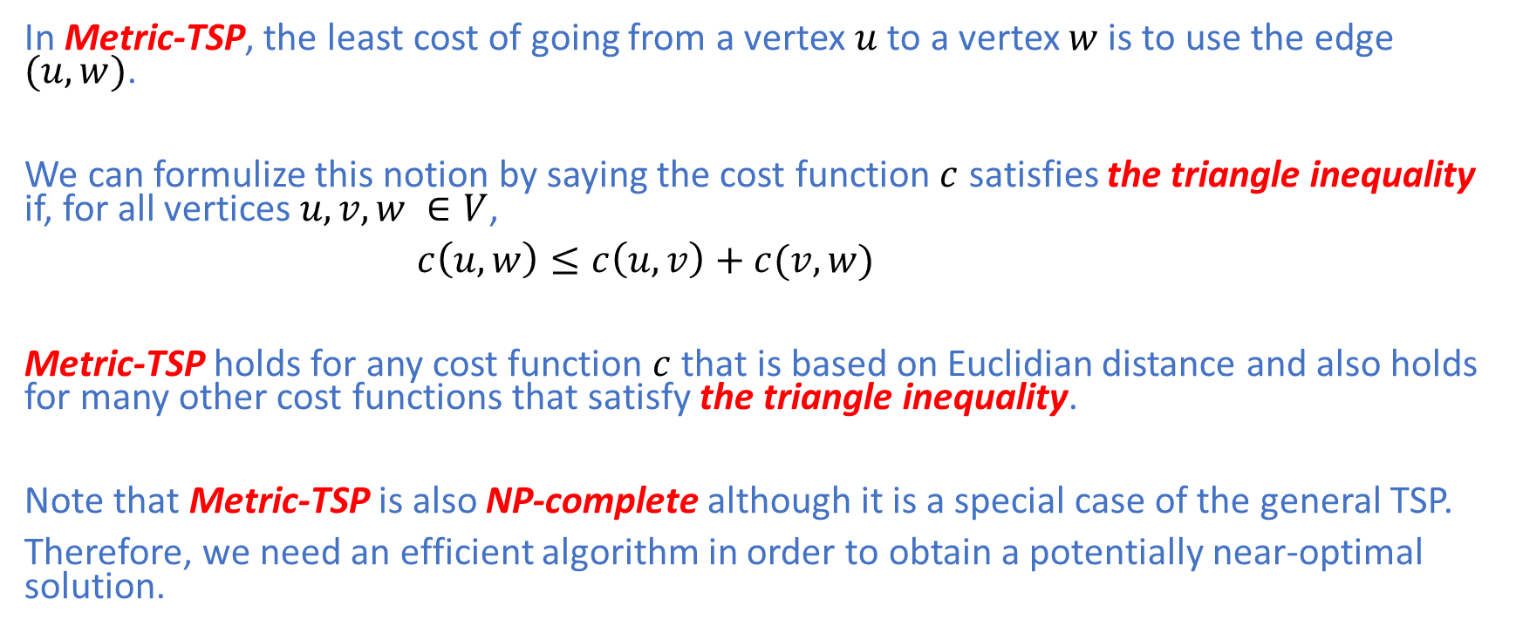
Metric-TSP
In Metric-TSP, the least cost of going from a vertex $u$ to a vertex $w$ is to use the edge $(u,w)$.
We can formulize this notion by saying the cost function $c$ satisfies the triangle inequality if, for all vertices $u,v,w ∈V$,
$c\left(u,w\right)≤c\left(u,v\right)+c(v,w)$
Metric-TSP holds for any cost function $c$ that is based on Euclidian distance and also holds for many other cost functions that satisfy the triangle inequality.
Note that Metric-TSP is also NP-complete although it is a special case of the general TSP.
Therefore, we need an efficient algorithm in order to obtain a potentially near-optimal solution.

Slide 18
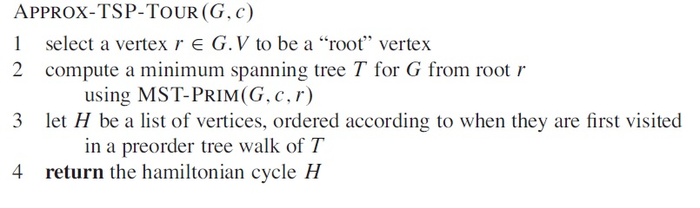

Metric-TSP
Knowing that Metric-TSP is NP-complete, we develop a 2-approximation algorithm $Approx−TSP−Tour$ with the help of Prim’s algorithm.

Slide 19
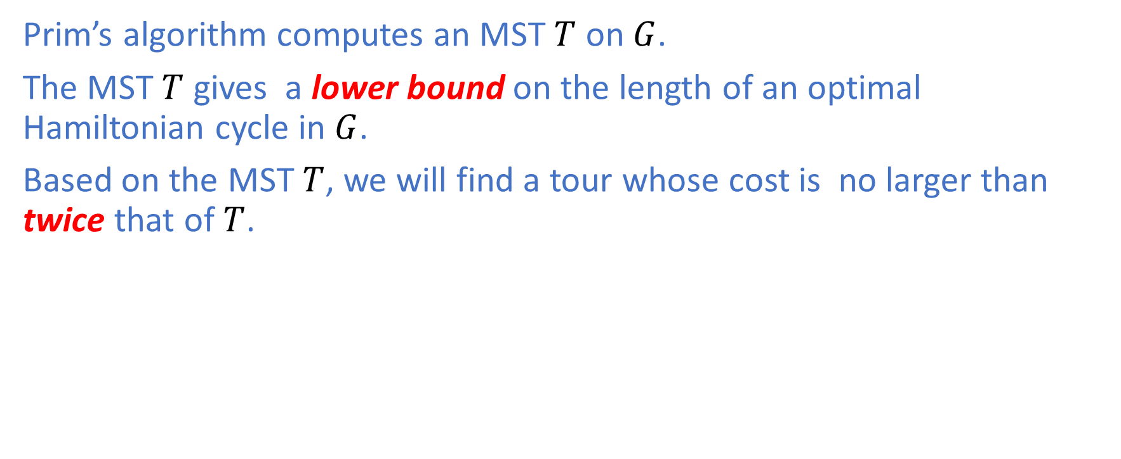
Metric-TSP
Prim’s algorithm computes an MST $T$ on $G$.
The MST $T$ gives a lower bound on the length of an optimal Hamiltonian cycle in $G$.
Based on the MST $T$, we will find a tour whose cost is no larger than twice that of $T$.

Slide 20
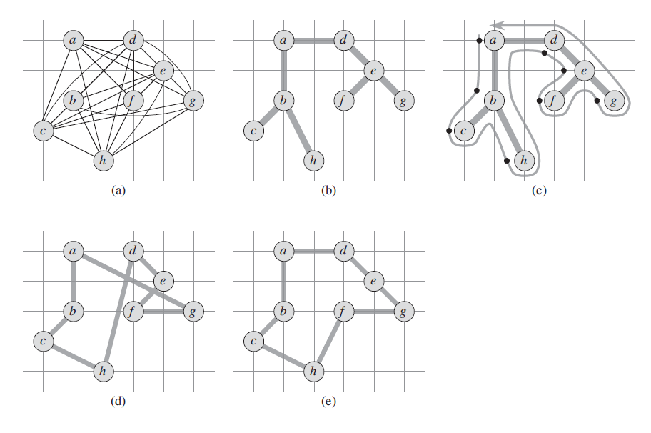
Metric-TSP: Example

Slide 21
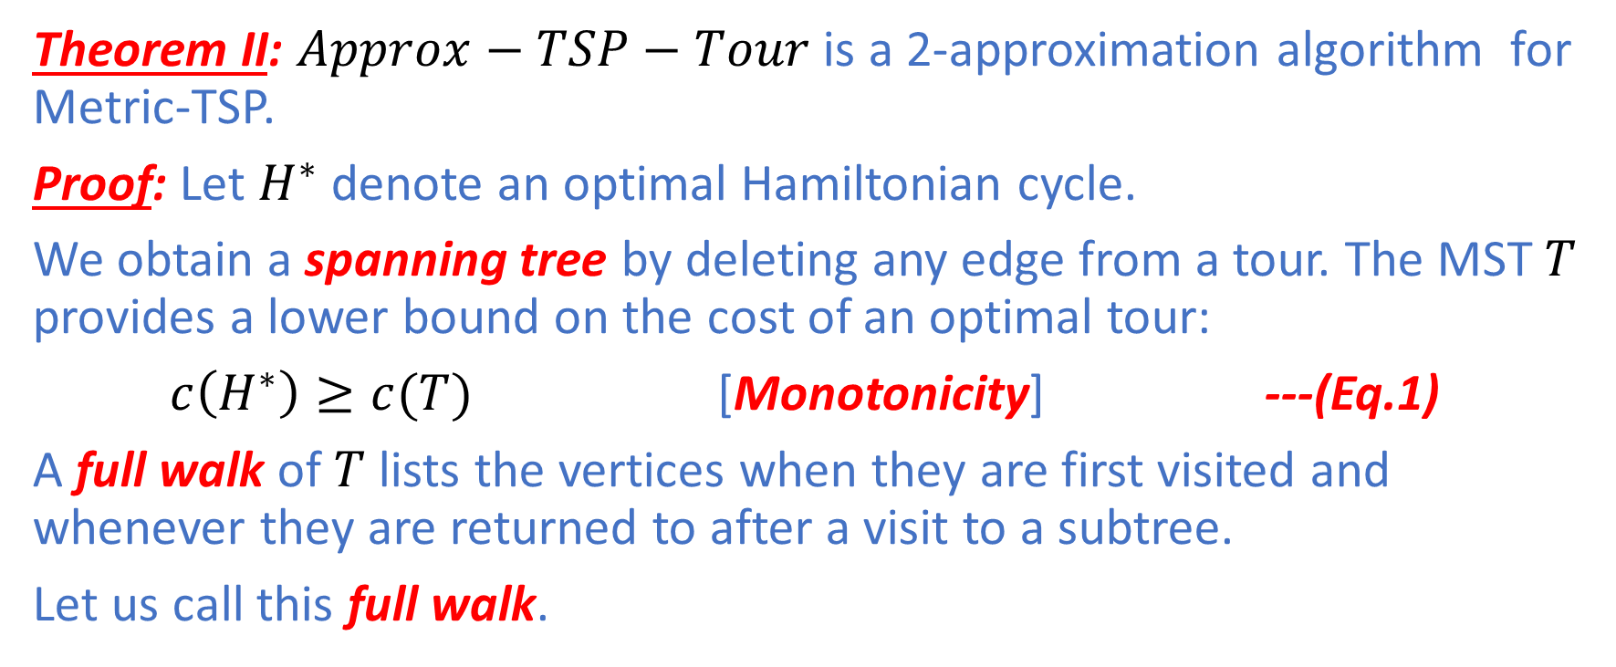
Metric-TSP
Theorem II: $Approx−TSP−Tour$ is a 2-approximation algorithm for Metric-TSP.
Proof: Let $H^{∗}$ denote an optimal Hamiltonian cycle.
We obtain a spanning tree by deleting any edge from a tour. The MST $T$ provides a lower bound on the cost of an optimal tour:
$c\left(H^{∗}\right)≥c(T)$ [Monotonicity] ---(Eq.1)
A full walk of $T$ lists the vertices when they are first visited and whenever they are returned to after a visit to a subtree.
Let us call this full walk.

Slide 22
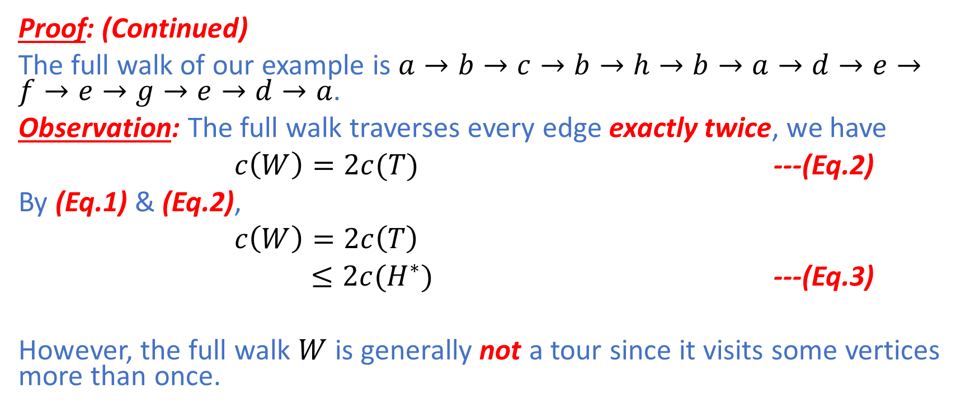
Metric-TSP
Proof: (Continued)
The full walk of our example is $a→b→c→b→h→b→a→d→e→f→e→g→e→d→a$.
Observation: The full walk traverses every edge exactly twice, we have
$c\left(W\right)=2c(T)$ ---(Eq.2)
By (Eq.1) & (Eq.2),
$c\left(W\right)=2c\left(T\right)$
$≤2c(H^{∗})$ ---(Eq.3)
However, the full walk $W$ is generally not a tour since it visits some vertices more than once.

Slide 23
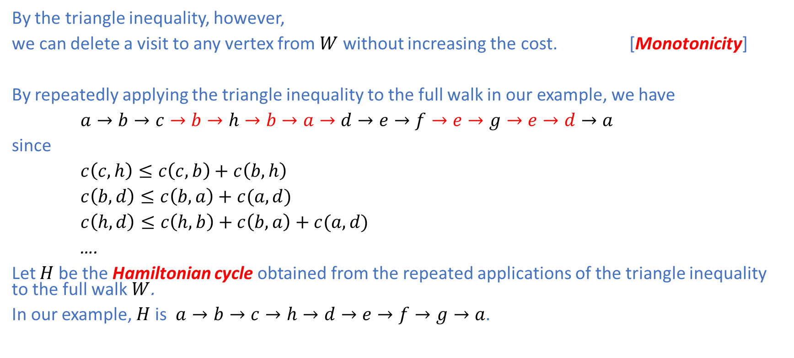
Metric-TSP
By the triangle inequality, however,
we can delete a visit to any vertex from $W$ without increasing the cost. [Monotonicity]
By repeatedly applying the triangle inequality to the full walk in our example, we have
$a→b→c→b→h→b→a→d→e→f→e→g→e→d→a$
since
$c\left(c,h\right)≤c\left(c,b\right)+c\left(b,h\right)$
$c\left(b,d\right)≤c\left(b,a\right)+c(a,d)$
$c\left(h,d\right)≤c\left(h,b\right)+c\left(b,a\right)+c(a,d)$
….
Let $H$ be the Hamiltonian cycle obtained from the repeated applications of the triangle inequality to the full walk $W$.
In our example, $H$is $a→b→c→h→d→e→f→g→a$.

Slide 24
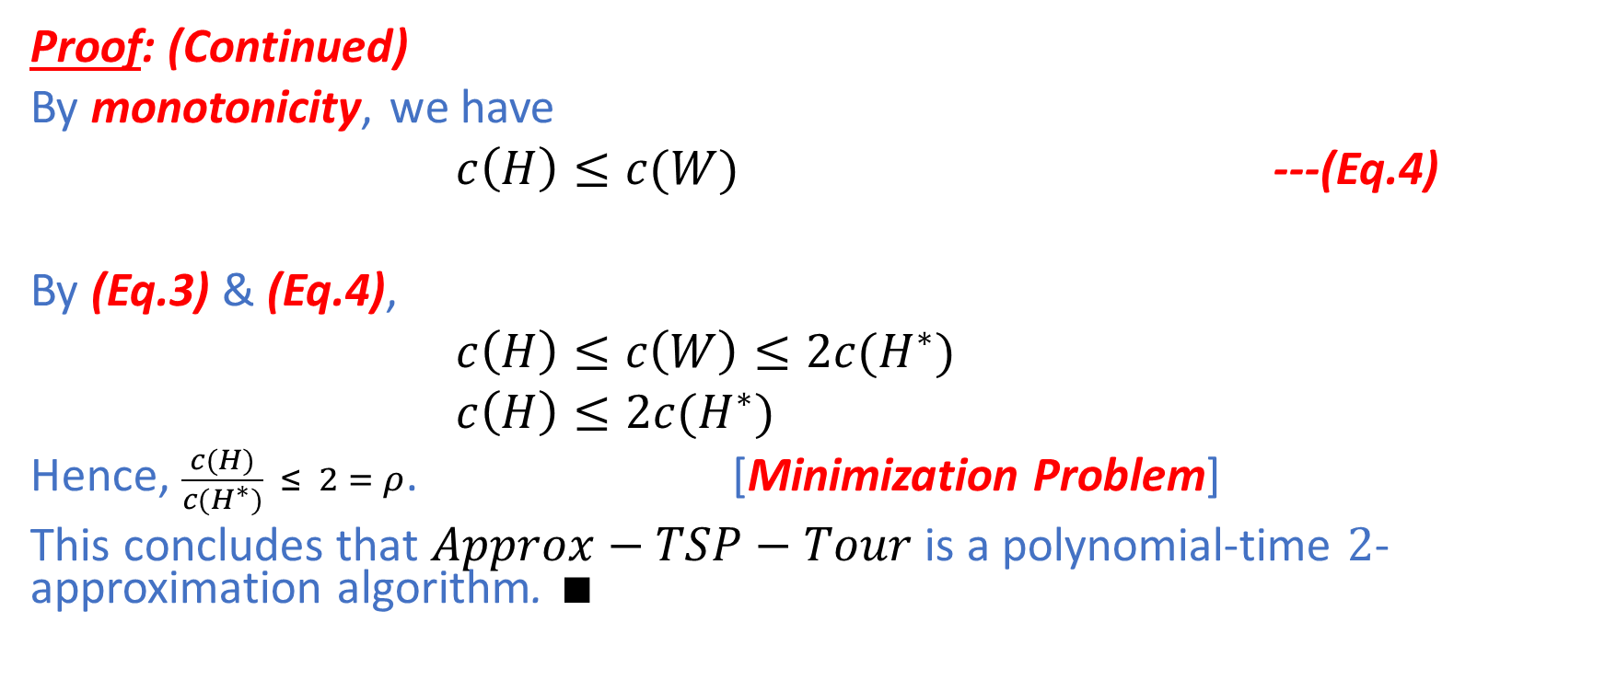
Metric-TSP
Proof: (Continued)
By monotonicity, we have
$c\left(H\right)≤c(W)$ ---(Eq.4)
By (Eq.3) & (Eq.4),
$c\left(H\right)≤c\left(W\right)≤2c(H^{∗})$
$c\left(H\right)≤2c(H^{∗})$
Hence, $\frac{c(H)}{c(H^{∗})} ≤ 2 = ρ$. [Minimization Problem]
This concludes that $Approx−TSP−Tour$ is a polynomial-time $2$-approximation algorithm. $∎$

Slide 25
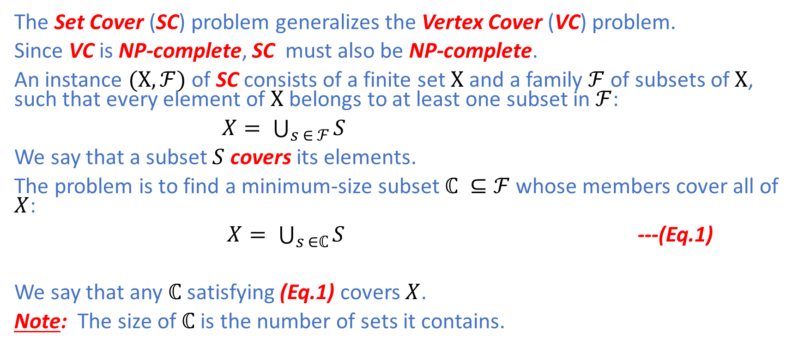
Set Cover
The Set Cover (SC) problem generalizes the Vertex Cover (VC) problem.
Since VC is NP-complete, SC must also be NP-complete.
An instance $(Χ,ℱ)$ of SC consists of a finite set $Χ$ and a family $ℱ$ of subsets of $Χ$, such that every element of $Χ$ belongs to at least one subset in $ℱ$:
$X= \bigcup_{s ∈ ℱ}{S}$
We say that a subset $S$ covers its elements.
The problem is to find a minimum-size subset $ℂ ⊆ℱ$ whose members cover all of $X$:
$X= \bigcup_{s ∈ℂ}{S}$ ---(Eq.1)
We say that any $ℂ$ satisfying (Eq.1) covers $X$.
Note: The size of$ℂ$ is the number of sets it contains.

Slide 26
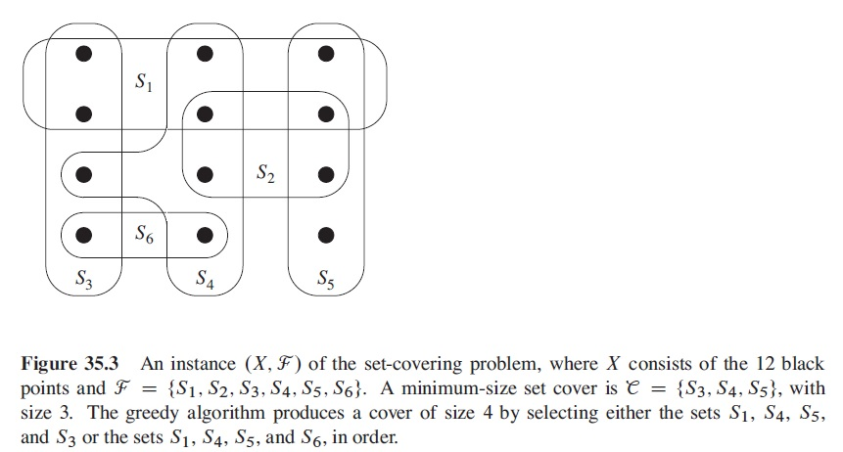
Set Cover: Example

Slide 27
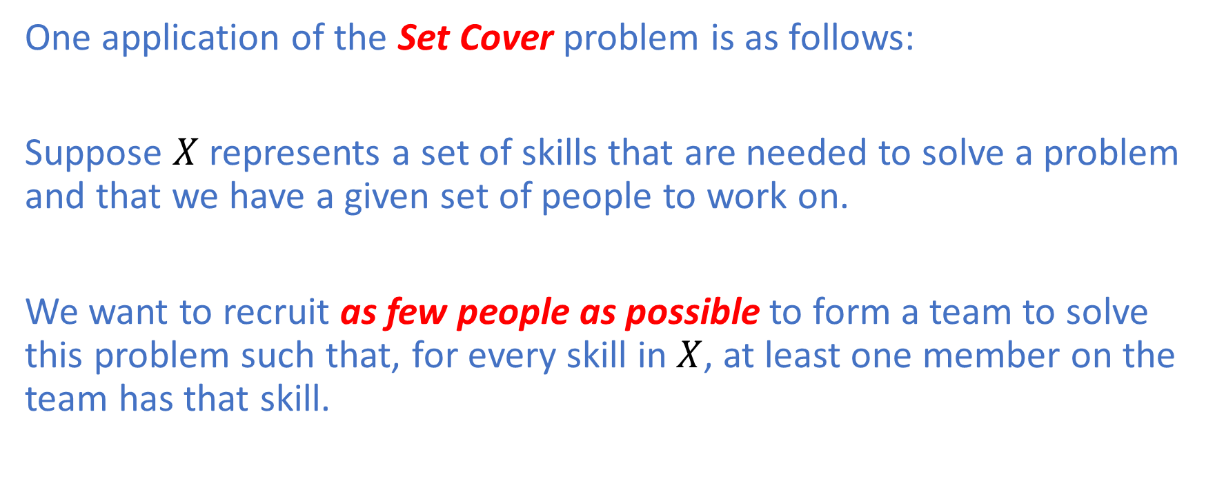
Set Cover: Application
One application of the Set Cover problem is as follows:
Suppose $X$ represents a set of skills that are needed to solve a problem and that we have a given set of people to work on.
We want to recruit as few people as possible to form a team to solve this problem such that, for every skill in $X$, at least one member on the team has that skill.

Slide 28
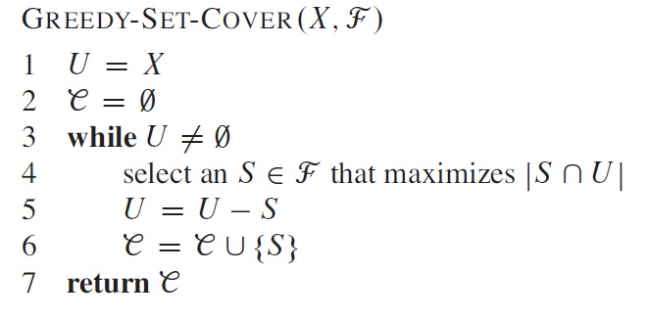

Set Cover
A greedy approximation algorithm $Approx−Set−Cover$ for SC works as follows:
Greedy Choice: $Approx−Set−Cover$iteratively picks a set $S$ that covers the largest number of remaining elements that remain uncovered, breaking ties arbitrarily.

Slide 29
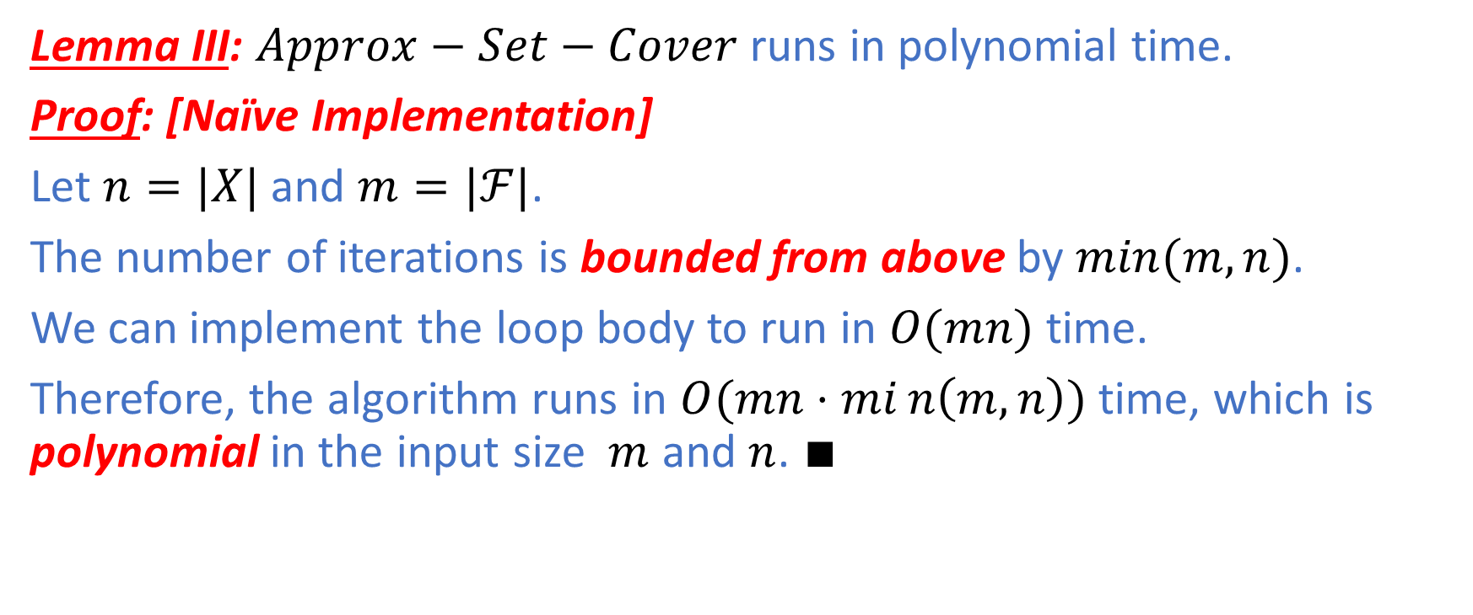
Set Cover: Running Time
Lemma III: $Approx−Set−Cover$ runs in polynomial time.
Proof: [Naïve Implementation]
Let $n=|X|$ and $m=|ℱ|$.
The number of iterations is bounded from above by $min(m,n)$.
We can implement the loop body to run in $O(mn)$ time.
Therefore, the algorithm runs in $O(mn⋅min\left(m,n\right))$ time, which is polynomial in the input size $m$ and $n$. $∎$

Slide 30
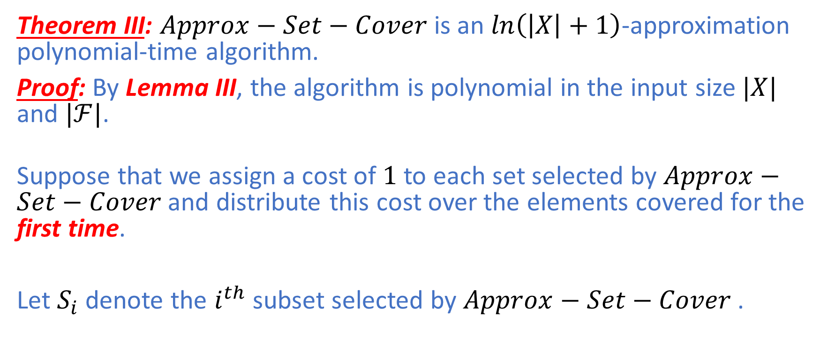
Set Cover
Theorem III: $Approx−Set−Cover$ is an $\ln\left(\left|X\right|+1\right)$-approximation polynomial-time algorithm.
Proof: By Lemma III, the algorithm is polynomial in the input size$|X|$ and $|ℱ|$.
Suppose that we assign a cost of $1$ to each set selected by $Approx−Set−Cover$ and distribute this cost over the elements covered for the first time.
Let $S_{i}$ denote the $i^{th}$ subset selected by $Approx−Set−Cover$ .

Slide 31
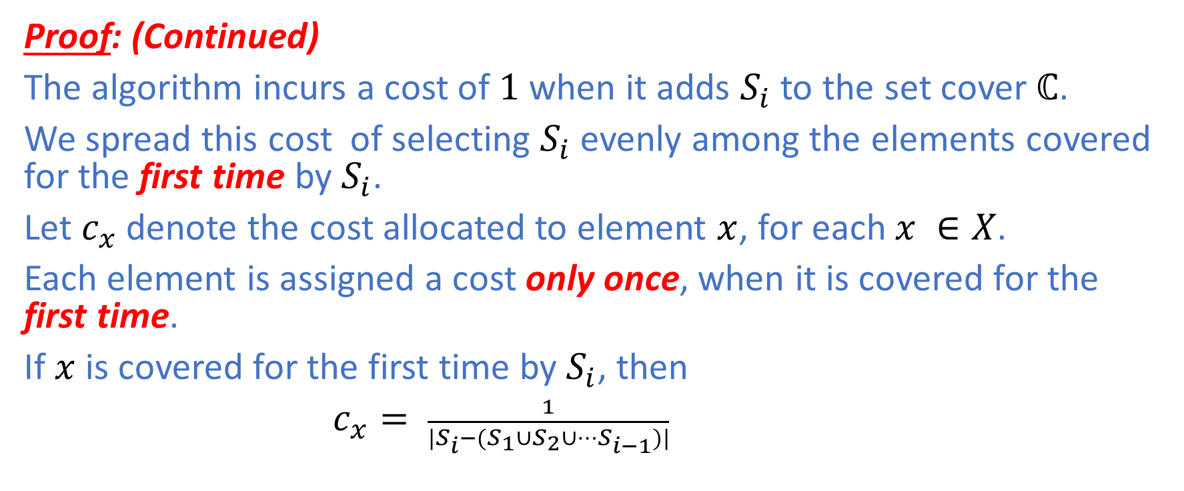
Set Cover
Proof: (Continued)
The algorithm incurs a cost of $1$ when it adds $S_{i}$ to the set cover $ℂ$.
We spread this cost of selecting $S_{i}$ evenly among the elements covered for the first time by $S_{i}$.
Let $c_{x}$ denote the cost allocated to element $x$, for each $x ∈X$.
Each element is assigned a cost only once, when it is covered for the first time.
If $x$ is covered for the first time by $S_{i}$, then
$c_{x}= \frac{1}{|S_{i}−(S_{1}∪S_{2}∪…S_{i−1})|}$

Slide 32
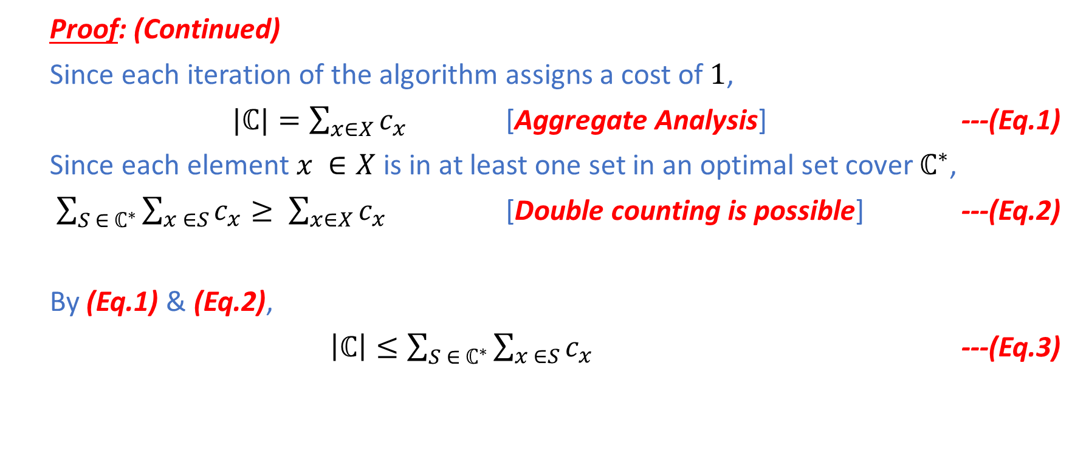
Set Cover
Proof: (Continued)
Since each iteration of the algorithm assigns a cost of $1$,
$|ℂ|=\sum_{x∈X}{c_{x}}$ [Aggregate Analysis] ---(Eq.1)
Since each element $x ∈X$ is in at least one set in an optimal set cover $ℂ^{∗}$,
$\sum_{S ∈ ℂ^{∗}}{\sum_{x ∈S}{c_{x}}}≥ \sum_{x∈X}{c_{x}}$ [Double counting is possible] ---(Eq.2)
By (Eq.1) & (Eq.2),
$\left|ℂ\right|≤\sum_{S ∈ ℂ^{∗}}{\sum_{x ∈S}{c_{x}}}$ ---(Eq.3)

Slide 33
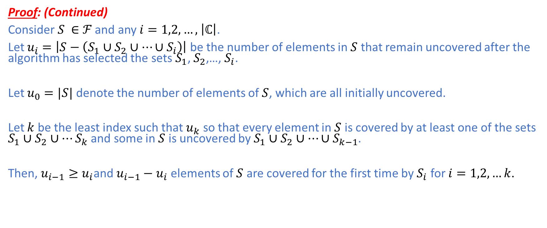
Set Cover
Proof: (Continued)
Consider $S ∈$ $ℱ$ and any $i=1,2,…,$ $\left|ℂ\right|$.
Let $u_{i}=\left|S−\left(S_{1}∪S_{2}∪…{∪S}_{i}\right)\right|$ be the number of elements in $S$ that remain uncovered after the algorithm has selected the sets $S_{1}$, $S_{2}$,…, $S_{i}$.
Let $u_{0}=|S|$ denote the number of elements of $S$, which are all initially uncovered.
Let $k$ be the least index such that $u_{k}$ so that every element in $S$ is covered by at least one of the sets $S_{1}∪S_{2}∪…S_{k}$ and some in $S$ is uncovered by $S_{1}∪S_{2}∪…{∪S}_{k−1}$.
Then, $u_{i−1}≥u_{i}$and $u_{i−1}−u_{i}$ elements of $S$ are covered for the first time by $S_{i}$ for $i=1,2,…k$.

Slide 34
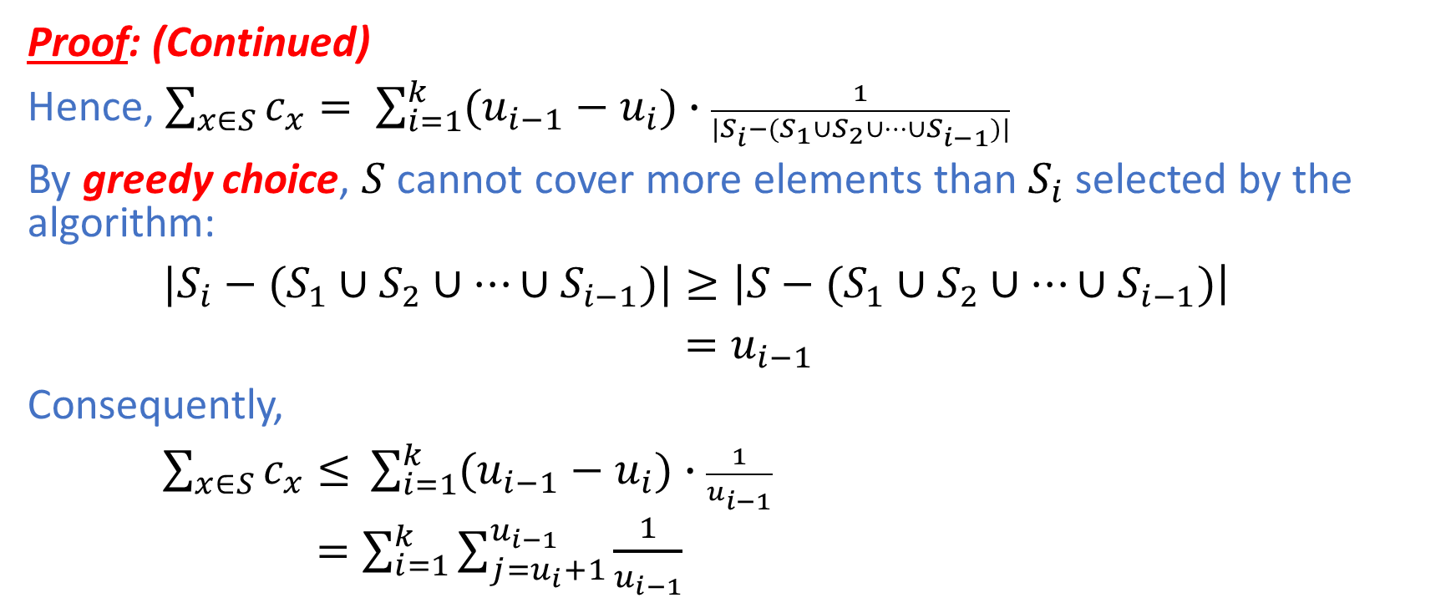
Set Cover
Proof: (Continued)
Hence, $\sum_{x∈S}{c_{x}}= \sum_{i=1}^{k}{(u_{i−1}−u_{i})∙\frac{1}{{|S_{i}−(S}_{1}∪S_{2}∪…{∪S}_{i−1})|}}$
By greedy choice, $S$ cannot cover more elements than $S_{i}$ selected by the algorithm:
${|S_{i}−(S}_{1}∪S_{2}∪…{∪S}_{i−1})|≥\left|{S−(S}_{1}∪S_{2}∪…{∪S}_{i−1})\right|$
$=u_{i−1}$
Consequently,
$\sum_{x∈S}{c_{x}≤ }$ $\sum_{i=1}^{k}{(u_{i−1}−u_{i})∙\frac{1}{u_{i−1}}}$
$=\sum_{i=1}^{k}{\sum_{j=u_{i}+1}^{u_{i−1}}{\frac{1}{u_{i−1}}}}$

Slide 35
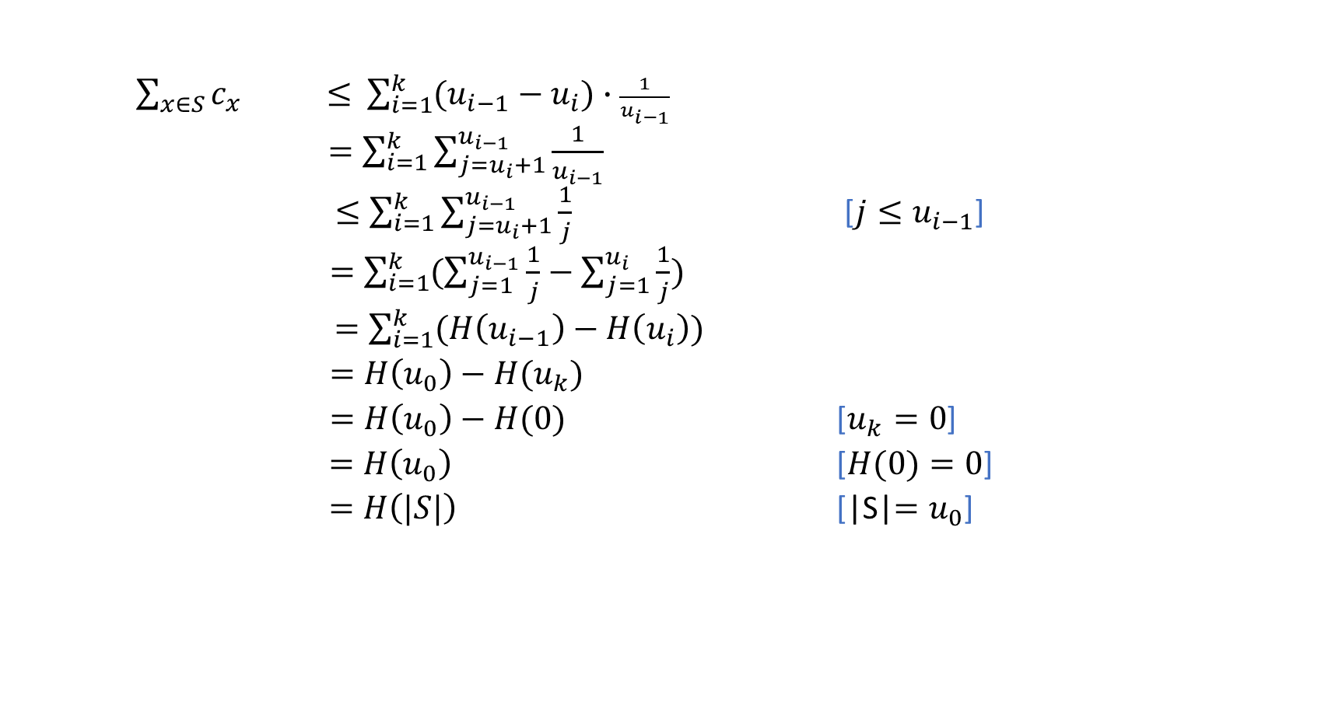
Set Cover
$\sum_{x∈S}{c_{x} ≤ }$ $\sum_{i=1}^{k}{(u_{i−1}−u_{i})∙\frac{1}{u_{i−1}}}$
$=\sum_{i=1}^{k}{\sum_{j=u_{i}+1}^{u_{i−1}}{\frac{1}{u_{i−1}}}}$
$≤\sum_{i=1}^{k}{\sum_{j=u_{i}+1}^{u_{i−1}}{\frac{1}{j}}}$ [$j≤u_{i−1}$]
$=\sum_{i=1}^{k}{(\sum_{j=1}^{u_{i−1}}{\frac{1}{j}−\sum_{j=1}^{u_{i}}{\frac{1}{j}})}}$
$=\sum_{i=1}^{k}{(H\left(u_{i−1}\right)−H\left(u_{i}\right))}$
$=H\left(u_{0}\right)−H(u_{k})$
$=H\left(u_{0}\right)−H(0)$ [$u_{k}=0$]
$=H\left(u_{0}\right)$ [$H(0)=0$]
$=H\left(|S|\right)$ [|S|$=u_{0}$]

Slide 36
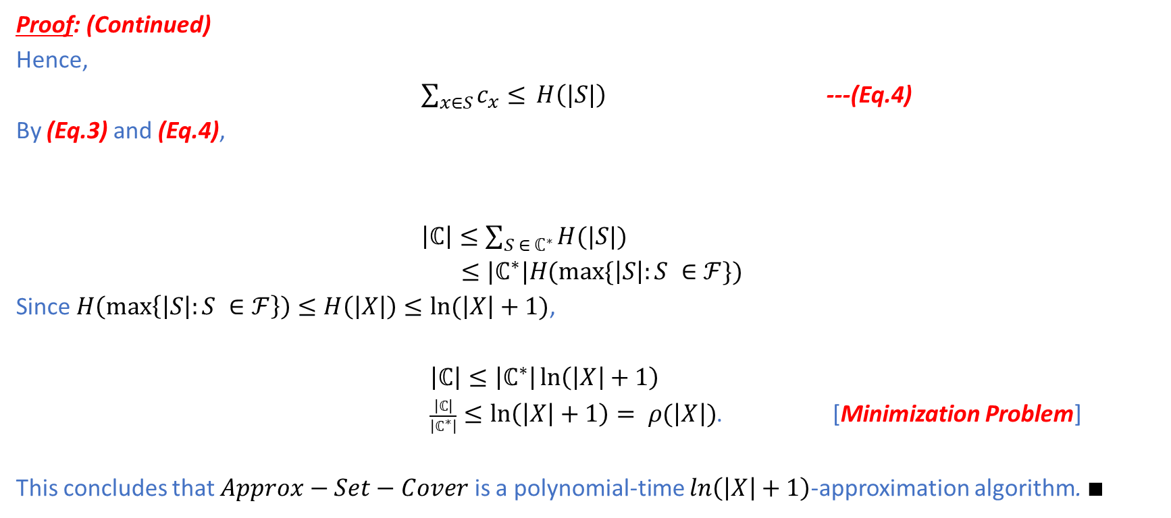
Set Cover
Proof: (Continued)
Hence,
$\sum_{x∈S}{c_{x}≤ }H\left(|S|\right)$ ---(Eq.4)
By (Eq.3) and (Eq.4),
$\left|ℂ\right|≤\sum_{S ∈ ℂ^{∗}}{H(|S|)}$
$≤|ℂ^{∗}|H(max⁡\{\left|S\right|:S ∈ℱ\})$
Since $H\left(\max\left\{\left|S\right|:S ∈ℱ\right\}\right)≤H\left(\left|X\right|\right)≤ln⁡(\left|X\right|+1)$,
$\left|ℂ\right|≤\left|ℂ^{∗}\right|\ln\left(\left|X\right|+1\right)$
$\frac{\left|ℂ\right|}{\left|ℂ^{∗}\right|}≤\ln\left(\left|X\right|+1\right)= ρ(\left|X\right|)$. [Minimization Problem]
This concludes that $Approx−Set−Cover$ is a polynomial-time $\ln\left(\left|X\right|+1\right)$-approximation algorithm. $∎$

